Slide 1
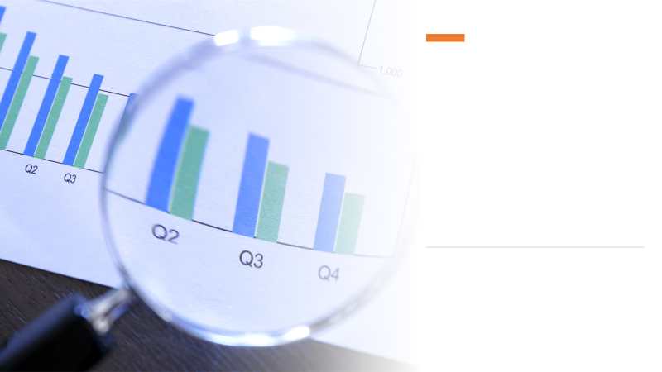
Marketing Campaign Analysis For Superhero U Event
SLU DV Group - 4

Slide 2

Team Description
Project Head : Debjit Datta.
Team Lead : Pranav Sharma.
Project Manager : Kailas Manoj, Mohammed Ameer, Shreyas Shete, Tushar Kumar.
Project Scribe : Soumyajit Kolay.
Project Lead : Anjali Mailavarapu.

Slide 3

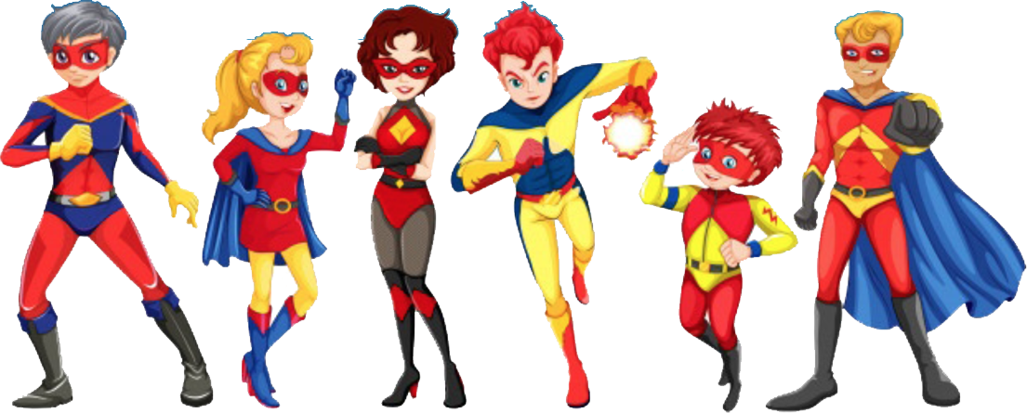
What is ?
Inventive and Imaginative event targeted at youth
Promotes creativity, innovation, and social responsibility
Emphasises Competition and Social Problem Solving
Pertains to United Nations’ mission to advance Equality in Access and Quality of Education
Aims to tackle the 5 P’s of Sustainable Development Goals (SDG), i.e., People, Prosperity, Planet, Partnerships, and Peace

Slide 4




More About ….
Imagine...
Illustrate…
Innovate...
Inspire...
Who would you be?
What problem are you solving?
How will you solve it?
Superhero can tell us their story.
Story can be content, illustration, posters, photo collages
Superhero that takes challenges and show us what they can do.
Superhero who come up with great ideas and ready to share.
creativity, in yourself and among your peers!

Slide 5
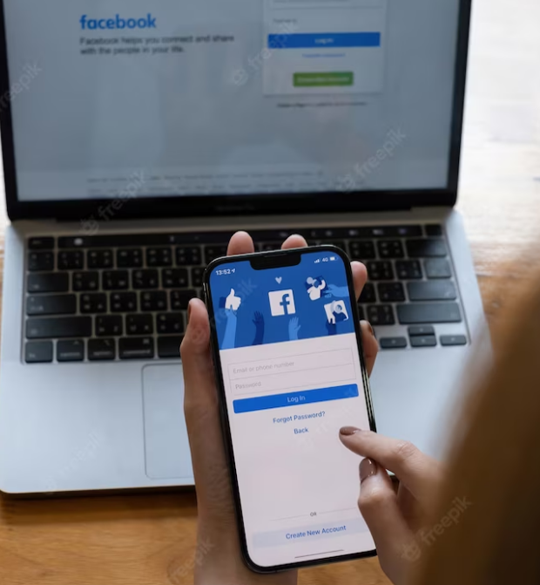




Why Facebook Ads ?
Understanding Target Audience
Massive User-Base
Segmentation Capability
Ads based on interests & demographics

Slide 6

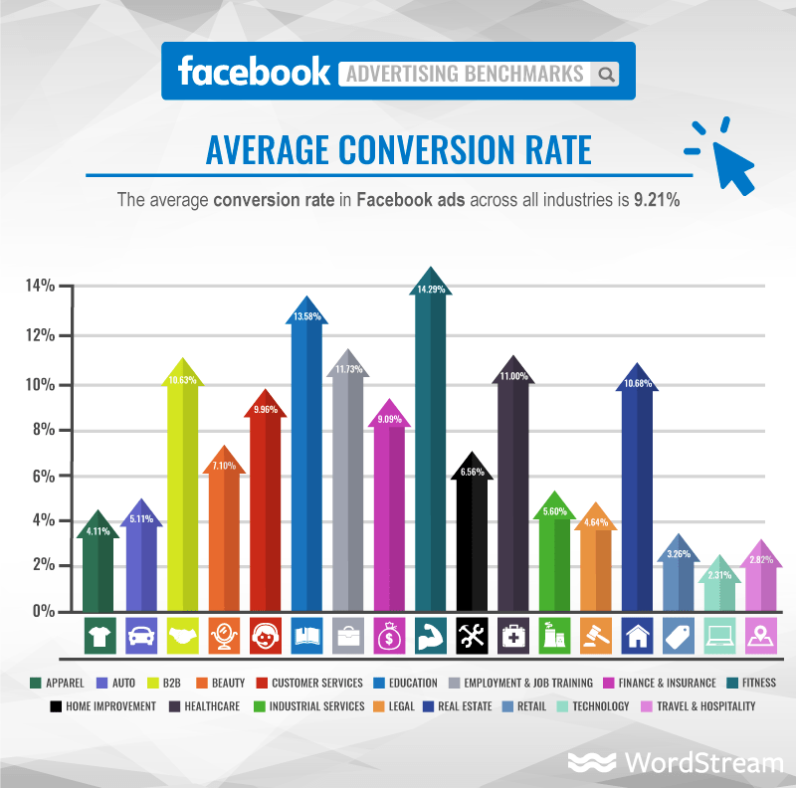


Thank you Ammer , now we will be discussing the Benefits of Facebook Advertisment..
Facebook advertisiment has many benefits but here we will be discussing the important ones.
Being one of the largest social media networks, Facebook has an effective way to drive traffic from active users.
Facebook targeting options are highly customizable, which mean that we can reach custom audiences based on their age, location, hobbies, interests, etc., which makes reaching the potential buyers even easier.
Third and the most important is The initial set-up for publishing the ad is very easy in Facebook. In addition to this easy setup, and the large reach of active users it provides a fast results.
In the right side of this slide we have attached a chart which is a study done by Wordstream for Facebook Advertising benchmark.
From this Chart we can conclude that the Average Conversion Rate of Facebook Ads across different industries is equivalent to 9.21% .
Moreover from the chart Fitness industries has the highest peak which shows that it got a big boom due to the use of Facebook Ads.
Over to Pranav…

Slide 7
Overview of Ad Campaigns
11 Ad Campaigns conducted by the Marketing Team
Audience: Educators, Students and Principals
Age groups: 13-17, 18-24, 25-34, 35-44, 45-54, 55-64
Geography groups:
Group 1: Australia, Canada, United Kingdom, Ghana, Nigeria, Pakistan, United States
Group 2: Australia, Canada, United Kingdom, Ghana, Niger, Nigeria, Nepal, Pakistan, Thailand, Taiwan

Slide 8
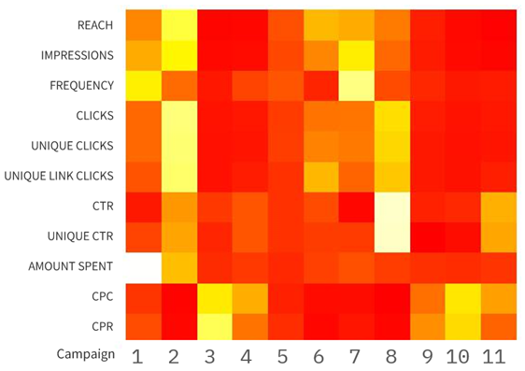
Overview of Ad Campaigns
Since Facebook Ads offer Advertisement Analytics to help improve the ads, we’ll look at the collected data and visualize the necessary metrics to make them more Cost Efficient and ensure good use of the Marketing Expenditure.

Slide 9
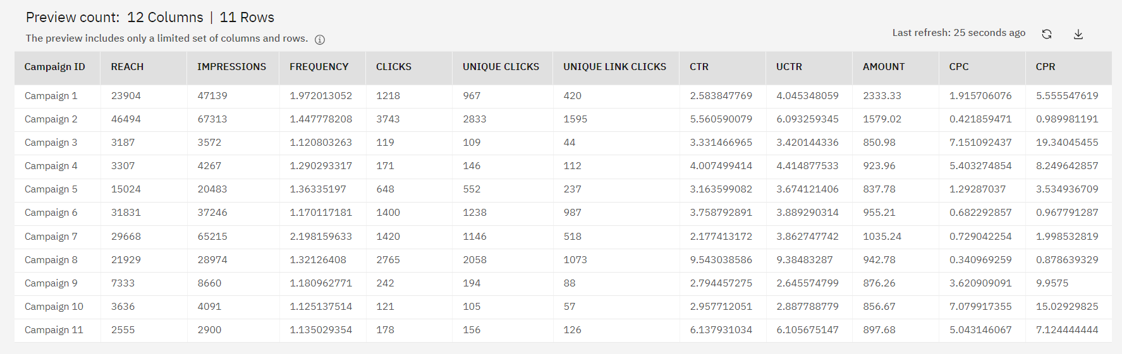
Simplified Dataset

Slide 10
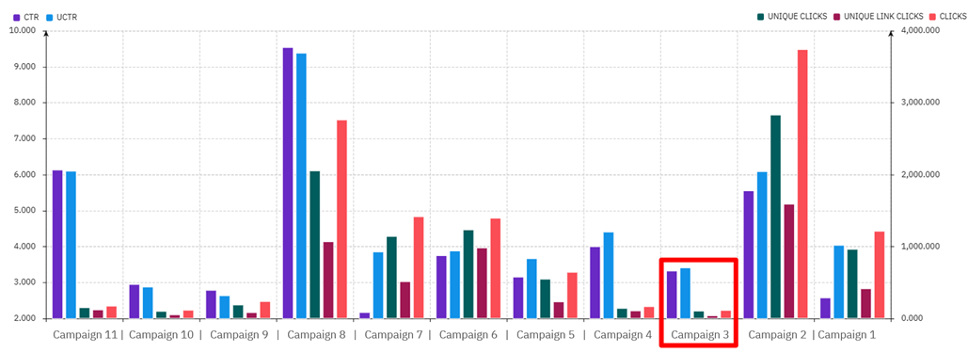
Analysis of Ad Campaigns

Slide 11
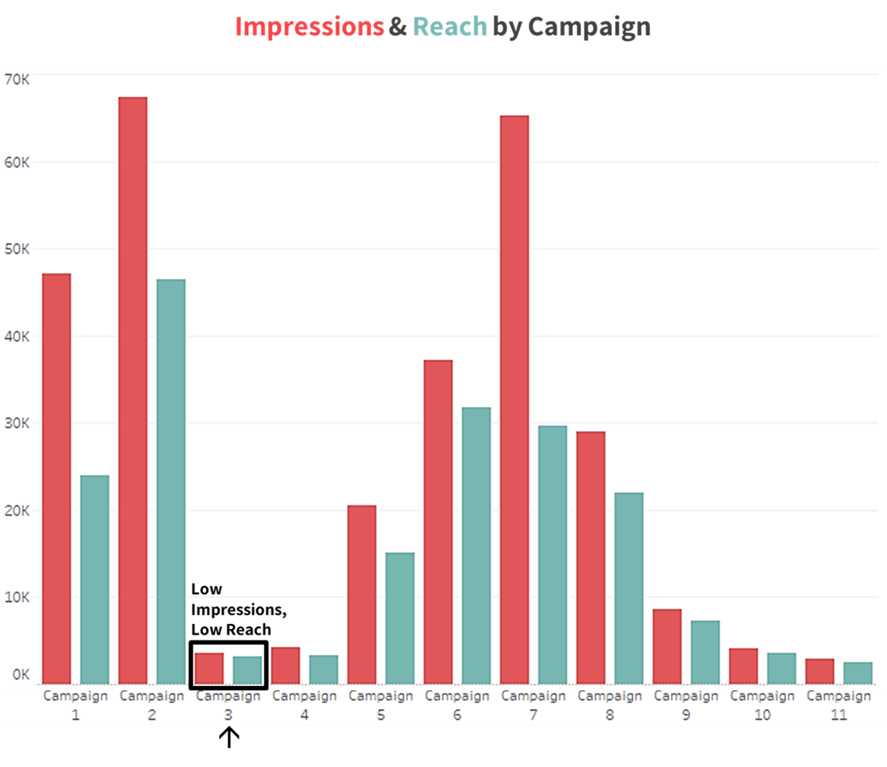
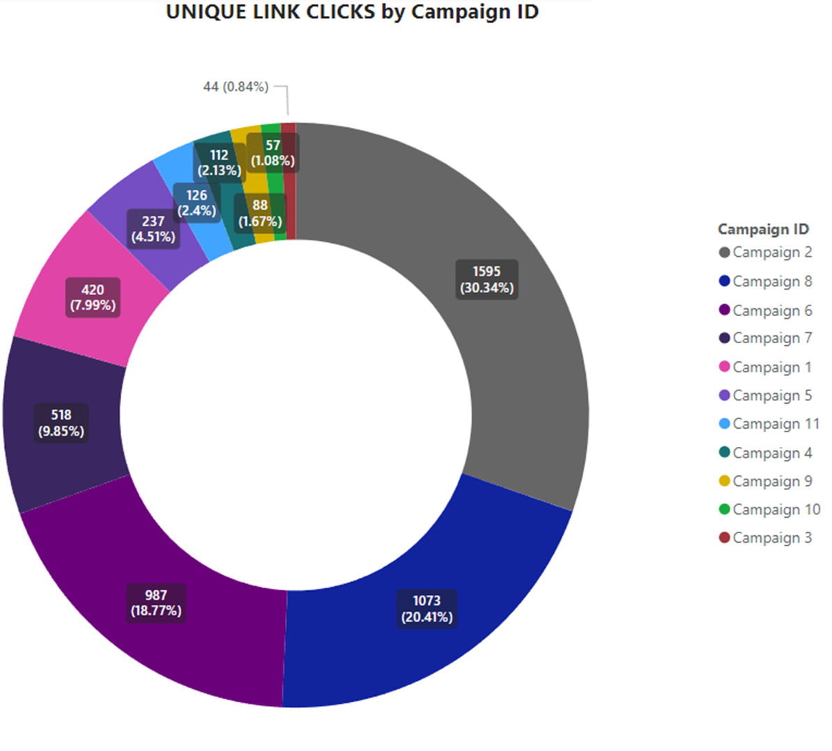
Analysis of Ad Campaigns
Notes:
Soumyajit Kolay

Slide 12
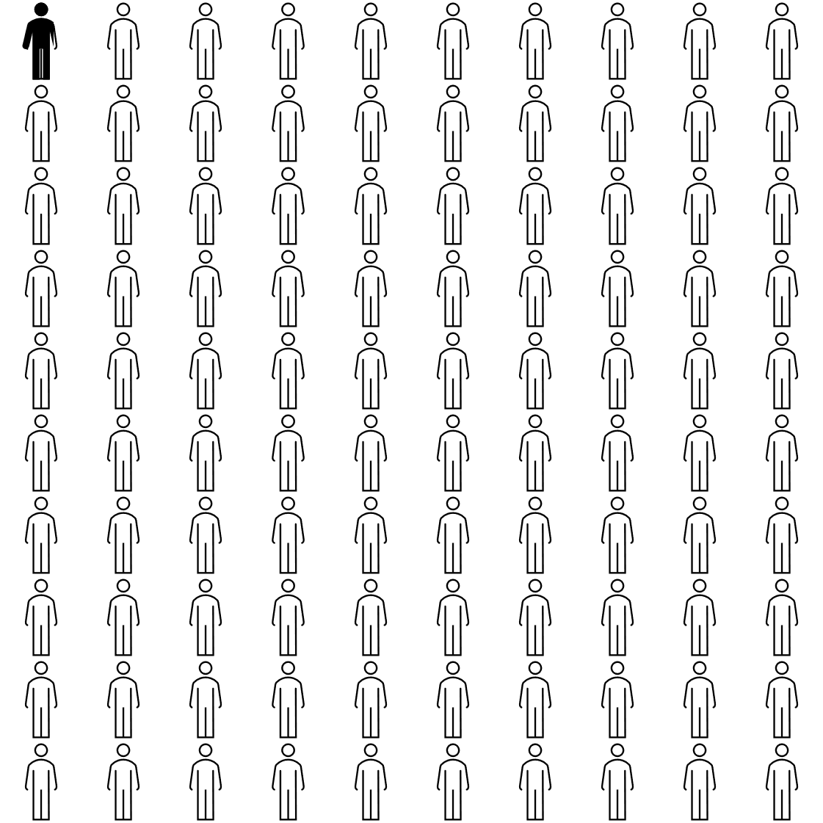
Analysis of Ad Campaigns
<1%
Total Results for Campaign 3

Slide 13
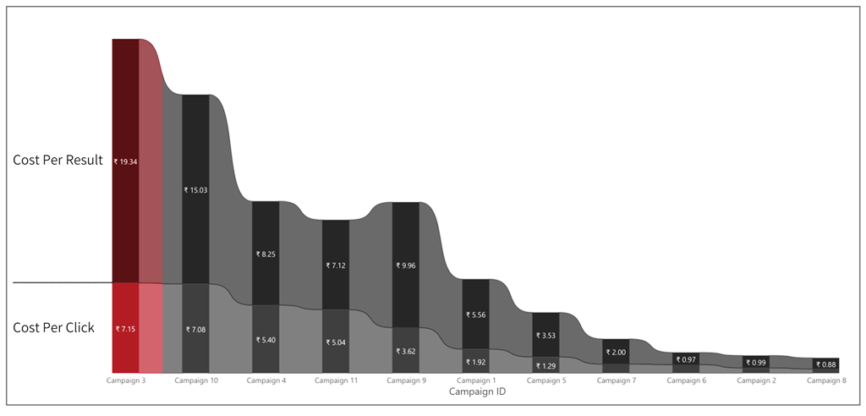
How much ₹₹₹ to get a participant?
<₹1.00 per participant
Notes:
Soumyajit Kolay

Slide 14

Conclusion
After analyzing the data on Marketing Campaigns for the Superhero U event using visualizations, it is clear that some campaigns performed worse than others, which can be removed to save Marketing Expenditure, one of which is very obvious.
₹851 (7.04%)
Campaign 3
Saved on Marketing (after removing Campaign 3)

Slide 15


